Slide 1
STM32

Slide 2
STM32F103C8
ARM 32-bit Cortex™-M3 CPU Core：
72 MHz maximum frequency,1.25 DMIPS/MHz
Single-cycle multiplication and hardware division
Memories：
64 or 128 Kbytes of Flash memory
20 Kbytes of SRAM
Timers：
Three 16-bit timers, each with up to 4 IC/OC/PWM or pulse counter and quadrature (incremental) encoder input
16-bit, motor control PWM timer with dead-time generation and emergency stop
SysTick timer 24-bit downcounter
Com munication interfaces：
Up to 2 x I2C interfaces
Up to 3 USARTs
Up to 2 SPIs (18 Mbit/s)

Slide 3
ST Standard Peripheral Library
This library is a firmware package which contains a collection of routines, data structures and macros covering the features of STM32 peripherals. It includes a description of the device drivers plus a set of examples for each peripheral. The firmware library allows any device to be used in the user application without the need for in-depth study of each peripheral’s specifications.
Using the Standard Peripherals Library has two advantages: it saves significant time that would otherwise be spent in coding, while simultaneously reducing application development and integration costs.
This is now a common practice among Cortex-M3 manufacturers (and others).

Slide 4
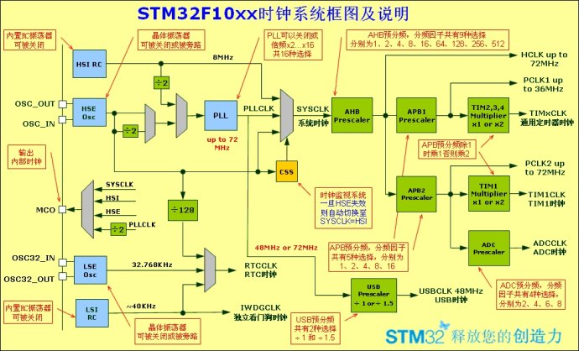
RCC

Slide 5
Initialization of GPIO
GPIO_InitTypeDef GPIO_InitStructure;
RCC_APB2PeriphClockCmd( RCC_APB2Periph_GPIOA , ENABLE );
GPIO_InitStructure.GPIO_Pin = GPIO_Pin_9; GPIO_InitStructure.GPIO_Mode = GPIO_Mode_OUT_PP; GPIO_InitStructure.GPIO_Speed = GPIO_Speed_50MHz;
GPIO_Init(GPIOA, &GPIO_InitStructure);

Slide 6
GPIO speed
typedef enum
{
GPIO_Speed_10MHz = 1,
GPIO_Speed_2MHz,
GPIO_Speed_50MHz
}GPIOSpeed_TypeDef;

Slide 7
GPIO Mode
typedef enum
{
GPIO_Mode_AIN = 0x0,
GPIO_Mode_IN_FLOATING = 0x04,
GPIO_Mode_IPD = 0x28,
GPIO_Mode_IPU = 0x48,
GPIO_Mode_Out_OD = 0x14,
GPIO_Mode_Out_PP = 0x10,
GPIO_Mode_AF_OD = 0x1C,
GPIO_Mode_AF_PP = 0x18
}GPIOMode_TypeDef;

Slide 8
Output and Input
Output low：GPIO_ResetBits(GPIOB, GPIO_Pin_0)
Output high：GPIO_SetBits(GPIOB, GPIO_Pin_0)
Input： GPIO_ReadInputDataBit(GPIOB,GPIO_Pin_7)

Slide 9
LED
1. IO口参数初始化
2.开启IO口对应时钟
3.置低IO口电平
4.点亮LED

Slide 10
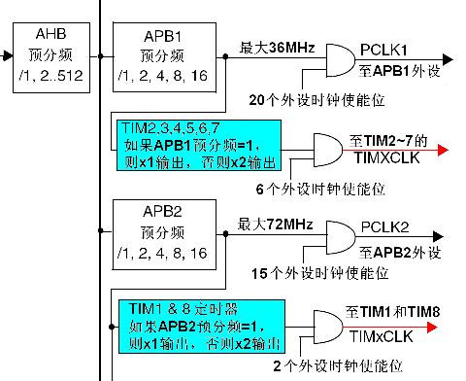
Clock source

Slide 11
Configuration of clock
RCC_APB1PeriphClockCmd(RCC_APB1Periph_TIM2, ENABLE);
RCC_APB2PeriphClockCmd(RCC_APB2Periph_TIM1, ENABLE);

Slide 12
Basic configuration of timer
TIM_TimeBaseInitTypeDef TIM_TimeBaseStructure;
TIM_DeInit(TIM2);
TIM_TimeBaseStructure.TIM_Period=500;
//prescaler is 1200,that is 72000000/72/500=2000Hz;
TIM_TimeBaseStructure.TIM_Prescaler=72-1; //set clock division
TIM_TimeBaseStructure.TIM_ClockDivision=TIM_CKD_DIV1; TIM_TimeBaseStructure.TIM_CounterMode=TIM_CounterMode_Up;
TIM_TimeBaseInit(TIM2,&TIM_TimeBaseStructure);
//clear the TIM2 overflow interrupt flag
TIM_ClearFlag(TIM2,TIM_FLAG_Update);
//TIM2 overflow interrupt enable
TIM_ITConfig(TIM2,TIM_IT_Update,ENABLE);
//enable TIM2
TIM_Cmd(TIM2,ENABLE);

Slide 13
Configuration of NVIC
NVIC_InitTypeDef NVIC_InitStructure;
NVIC_InitStructure.NVIC_IRQChannel = TIM2_IRQChannel; NVIC_InitStructure.NVIC_IRQChannelPreemptionPriority = 0; NVIC_InitStructure.NVIC_IRQChannelSubPriority = 4; NVIC_InitStructure.NVIC_IRQChannelCmd = ENABLE; NVIC_Init(&NVIC_InitStructure);

Slide 14
Interrupt function
void TIM2_IRQHandler(void)
{
......
}

Slide 15
Task1
1、点亮LED灯
2、启动一个电机
由于Task1比较简单，所以当天验收

Slide 16
We Want You
对无人机或者硬件有较大兴趣的同学可以私聊我
15级移动飞行器实训QQ群：456233480，请进群务必修改群名片，格式：组号+姓名，如：
9+吴彦祖，TA的话群名片为TA-姓名，太久没修改的话会被当作其他人踢走哦
由于实验室无法或者不方便使用FTP传输文件，所以请每组务必至少有一位成员加入QQ群，以便下载课件、代码，接收重要通知等

Slide 17
About PPT
最后的Project的DDL，陈龙老师已经问了教务员老师了，正在等回复中，如果可以推迟到下学期开学后就最好了，如果不能的话，大家可以在线交流，把飞机托付给组里一个值得信任的同学~~~
课程进度以及后面的PPT，我尽量把后面的PPT都尽快写好，但是同学们也不用着急，课上有时间给大家吸收理解知识的，还有我们强大的TA帮助，实训肯定可以非常愉快

